Slide 1

MOBILE DEVELOPMENT
COMPUTER SCIENCE
Topic 6:
Data Sources
version 1.0
Copyright © 2020 by Singapore Institute of Management Pte Ltd. All rights reserved.

Slide 2

Learning Outcomes
After studying this topic and the recordings online, you should be able to:
Topic 6 – Data Sources
Syntax Transformers
Data Sources
Loading data from a JSON file in React Native
Loading data from a XML file in React Native

Slide 3

Syntax Transformers
Javascript is a programming language that was created since 1995.
It brought a lot of supports to multiple platforms like web/mobile/software development.
ECMAScript is the official name of the language.
Notes:
B

Slide 4
Syntax Transformers
The ECMAScript till date have multiple versions ranging from ES1 to ES6 (Current).
The functionalities/syntax from each of these version are inter-compatible and can be inter-used through interpreters.
Notes:
B

Slide 5
Syntax Transformers
Since there are many version syntax, older JS syntax tend to have larger block code implementation which makes programming slightly more troublesome.
Thus, syntax transformers are created to enable flexible, efficient and implementation of latest JS syntax.
Notes:
B

Slide 6
Syntax Transformers
Syntax transformers make writing code more enjoyable by allowing you to use new JavaScript syntax without having to wait for support on all interpreters.
React Native ships with the Babel JavaScript compiler.
Notes:
B

Slide 7
Syntax Transformers
Babel is a toolchain that is mainly used to convert ECMAScript 2015+ code into a backwards compatible version of JavaScript in current and older browsers or environments.
Important things on Babel features:
Transform syntax
Polyfill features that are missing in your target environment
Source code transformations
Notes:
B

Slide 8
Syntax Transformers
Since React Native comes with Babel Javascript compiler.
JSX is automatically enabled to support the structure of our Javascript codes.
Notes:
B

Slide 9
Syntax Transformers
Let’s look at some React Native’s enabled transformations:
Arrows and Lexical this
Arrows are a function shorthand using the => syntax.
Unlike functions, arrows share the same lexical this as their surrounding code.
If an arrow is inside another function, it shares the "arguments" variable of its parent function.
Notes:
B

Slide 10
Syntax Transformers
Arrows and Lexical this
// Expression bodies var odds = evens.map(v => v + 1); var nums = evens.map((v, i) => v + i); // Statement bodies nums.forEach(v => { if (v % 5 === 0) fives.push(v); });
Notes:
B

Slide 11
Syntax Transformers
Classes
Classes are syntactic sugar over the prototype-based OO pattern.
Having a single convenient declarative form makes class patterns easier to use, and encourages interoperability.
Classes support prototype-based inheritance, super calls, instance and static methods and constructors.
Notes:
B

Slide 12
Syntax Transformers
Classes
class tessApp extends components { … }
Notes:
B

Slide 13
Syntax Transformers
Template Strings
Template strings provide syntactic sugar for constructing strings.
// Basic literal string creation `This is a pretty little template string.` // Multiline strings `In ES5 this is not legal.` // Interpolate variable bindings var name = "Bob", time = "today"; `Hello ${name}, how are you ${time}?`
Notes:
B

Slide 14
Syntax Transformers
Destructing
Destructuring allows binding using pattern matching, with support for matching arrays and objects.
Destructuring is fail-soft, similar to standard object lookup foo["bar"], producing undefined values when not found.
let test = { item: ‘A’, itemDescrip: ‘hello’ } let {item} = test alert(item);
Notes:
B

Slide 15
Syntax Transformers
Let & Const
Block-scoped binding constructs.
let is the new var.
const is single-assignment.
Static restrictions prevent use before assignment.
Notes:
B

Slide 16
Syntax Transformers
Let & Const
function f() { { let x; { // this is ok since it's a block scoped name const x = "sneaky"; // error, was just defined with `const` above x = "foo"; } // this is ok since it was declared with `let` x = "bar"; // error, already declared above in this block let x = "inner"; } }
Notes:
B

Slide 17
Syntax Transformers
For of
Provides new and shorter syntax of the for iteration.=
Faster approach of looping things like array.
let test = [1, 2, 3 , 4]; //Access value of each array position for(let num of test) { console.log(num); } //Access array position in an array for(let pos in test) { console.log(pos); }
Notes:
B

Slide 18
Syntax Transformers
Link to JSX transformers:
https://reactnative.dev/docs/javascript-environment
Notes:
B

Slide 19
Data Sources
Data is an essential piece to any kinds of application, not only mobile applications.
It requires a considerable amount of thoughts in terms of:
Where the data comes from?
Data storage
Data integrity
Methods of accessing those data
Notes:
B

Slide 20
Data Sources
Let’s take an example of Twitter.
The Twitter application lazy loads tweet data into the application. This is done by communicating with the server’s API that returns the data in a certain data format.
Notes:
B

Slide 21
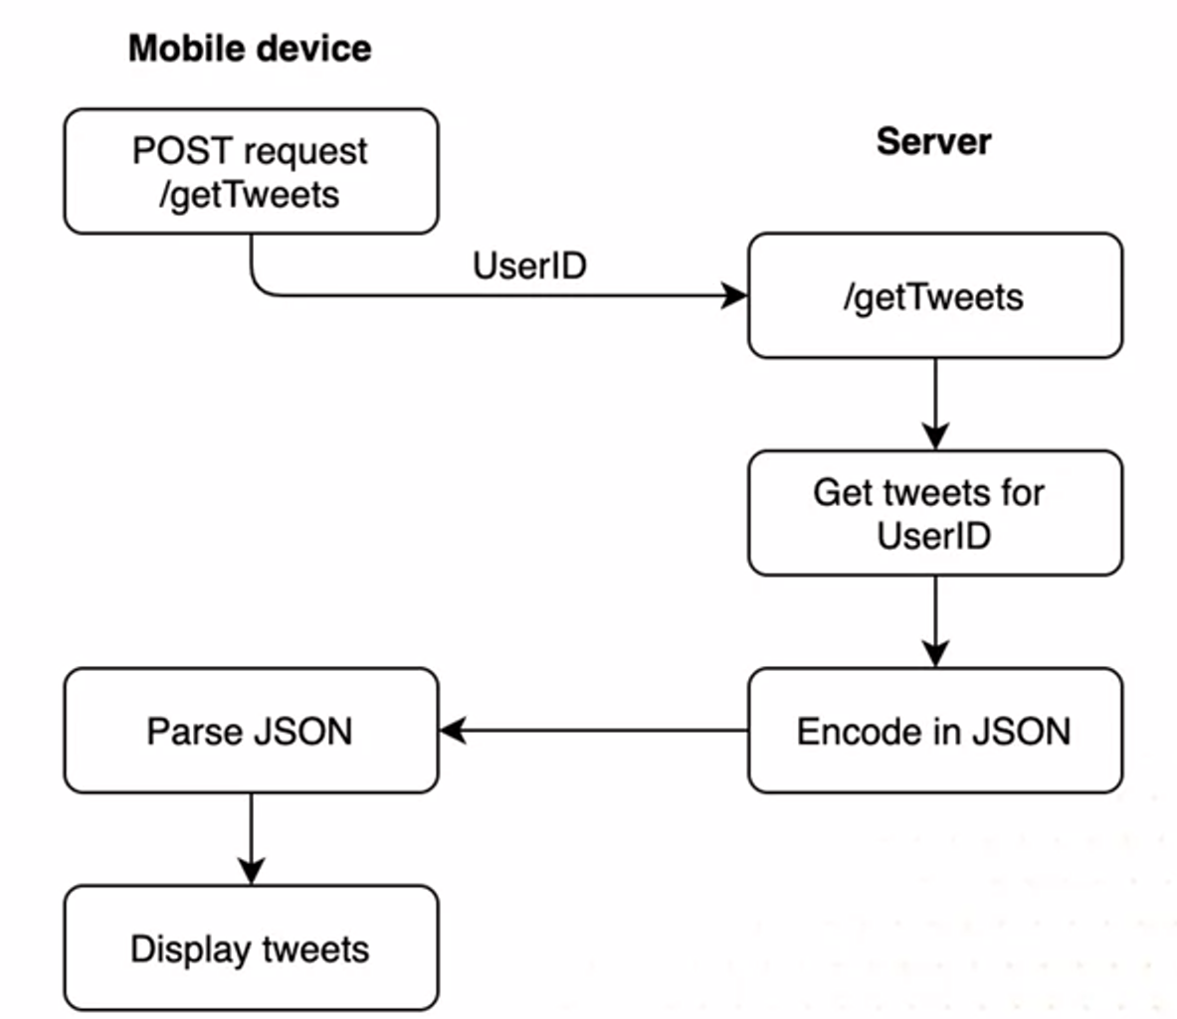
Data Sources
Let’s take an example of Twitter.
Notes:
B

Slide 22
Data Sources
The server’s provides a few door way methods to access data in a secure manner.
API (Application Programming Interface)
API stands for application programming interface, which is a set of definitions and protocols for building and integrating application software.
Notes:
B

Slide 23
Data Sources
The server’s provides a few door way methods to access data in a secure manner.
Post & Get Methods
Developed for HTTP to work as a request and response protocol between a client and a server.
GET is used to request data from a specified resource.
POST is used to send data to a server to create/update a resource.
Notes:
B

Slide 24
Data Sources
These methods returns the data in certain file types/formats where the application’s are programmed to understand how to retrieve data values.
File types/formats specifically for mobile application.
JSON
XML
Notes:
B

Slide 25
Data Sources
JSON
JSON stands for JavaScript Object Notation
It is a lightweight format for storing and transporting data
Often used when data is sent from a server to a web page
Its "self-describing" and easy to understand
Notes:
B

Slide 26
Data Sources
JSON
An example of JSON objects:
An example of JSON arrays:
{"firstName":"John", "lastName":"Doe"}
{ "employees":[ {"firstName":"John", "lastName":"Doe"}, {"firstName":"Anna", "lastName":"Smith"}, {"firstName":"Peter", "lastName":"Jones"} ] }
Notes:
B

Slide 27
Data Sources
XML
XML stands for Extensible Markup Language
It is a markup language much like HTML
Designed to store and transport data
Designed to be self-descriptive
Does not do anything
Notes:
B

Slide 28
Data Sources
XML
<note> <to>Tove</to> <from>Jani</from> <heading>Reminder</heading> <body>Don't forget me this weekend!</body> </note>
Notes:
B

Slide 29
Data Sources
XML
The XML above is quite self-descriptive:
It has sender information
It has receiver information
It has a heading
It has a message body
But still, the XML above does not DO anything. XML is just information wrapped in tags.
You have to write the codes receive, store, or display it.
Notes:
B

Slide 30
Loading data from a JSON file
Here I will demonstrate how to fetch data from a local JSON file in React Native.
Notes:
B

Slide 31
Loading data from a XML file
Here I will demonstrate how to fetch data from a local XML file in React Native.
Notes:
B

Slide 32
Saving Data in React Native
Previous section we talk about how to retrieve data through a few methods. However, there is one more method to quickly save data and load them.
That is, to tap on the phones storage memory.
Notes:
B

Slide 33
Saving Data in React Native
Similar to native mobile application like the iOS and Android platforms, React Native does provide functions that can store offline data in the React Native applications.
We do that by using the AsyncStorage API that React Native provides.
Notes:
B

Slide 34
Saving Data in React Native
AsyncStorage is a simple, asynchronous, unencrypted by default module that allows you to persist data offline in React Native apps.
The persistence of data is done in a key-value storage system.
Notes:
B

Slide 35
Saving Data in React Native
There are numerous scenarios where this module can be beneficial.
Persisting data in a mobile app has benefits such as when the user restarts the app, the data or the setting variables being available to the user in the state they left before closing the app.
Notes:
B

Slide 36
Saving Data in React Native
I will be demonstrating on how to use AsyncStorage.
But first, create a new project and execute the following installation for AsyncStorage to your project.
npm install @react-native-async-storage/async-storage
Notes:
B

Slide 37
That’s all for today!
If you have any questions, please feel free to reach out to me at this email.
kydsim001@mymail.sim.edu.sg
Notes:
B

Slide 38
END OF LESSON

